Slide 1
Entering the Matrix: the basics of NGS Output files
Jonathan B. Puritz
Marine Science Center
Northeastern University

Slide 2

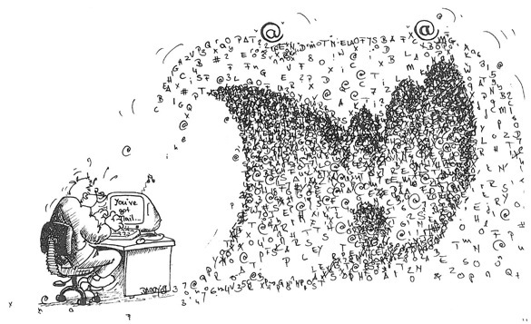
A tsunami of data
B@G 2016

Slide 3
Getting familiar with FASTQ
B@G 2016

Slide 4
Getting familiar with FASTQ
@HWUSI-EAS1877:1234:07-30-12_Puritz2:1:1:12814:984 1:N:0:ACAGTG
ACTTTTGACCGGACTTGTGATAGACTTCCGATGGACTCGNCTACTTATTCAGGAAATCATTGAGGTTTCATCCGGTAACAGTTGCATTTCTCCTAT
+
99999@CC@@CC@CCCC@@@C@CC@CCCCCC@@@@7777#58454C@@CC@@@@@@@@@@@@@@@@@@@@@C@@@@@@@CC@@C@C@C@@@@@@@C
@HWUSI-EAS1877:1234:07-30-12_Puritz2:1:1:13449:983 1:N:0:ACAGTG
GCCAAAACTCCACAAGTAGGGGTGGATTTTGATGGAGTTNGGAAGGTTAGGGTTATTTTTTTCCTATCTTGGAGTTTCCTCTACG
+
66666@C@@C@@@C@@@@@@:::222@@@@<<<<<*%)*#-----8886899997<<222222@@@@@@@@@8@@@@@@@:@@@@
@HWUSI-EAS1877:1234:07-30-12_Puritz2:1:1:15644:982 1:N:0:ACAGTG
TACCAGTGCATTTGGTTGACGCACACTTGAGATGNCCAACTCTCCCGACGAAGTAAATTGTTGGAGGACTAGATTCTTGATCA
+
CCC@CC@@@@<<:<<@@@@@@@C@@@C@@@3354#22322@@@@@<<8<<@@@@@::::::::<7:<<::@@@@8:6:::@@@
@HWUSI-EAS1877:1234:07-30-12_Puritz2:1:1:16185:982 1:N:0:ACAGTG
GGCCAACAAGTCGGCAAAAGGACAGGTCTTGAAACCCAGNACTTGCGGAGAAAATGTAAGATATAGCGCATCAATTCCAGTATTGTACCCCTATGT
+
77777@C@@C@@C@@@@C@C@@CC@@@@C@@@@@@4555#77777@@@@@@@722@C@CC8888844444@@@:@:<<<::<<<:@@8:@@@@@4<
B@G 2016

Slide 5
Getting familiar with FASTQ
@HWUSI-EAS1877:1234_Puritz2:1:1:12814:984 1:N:0:ACAGTG
ACTTTTGACCGGACTTGTGATAGACTTCCGATGGACTCGNCTACTTATTCAGGAAATCATTGAGGTTTCATCCGGTAACAGTTGCATTTCTCCTAT
+
99999@CC@@CC@CCCC@@@C@CC@CCCCCC@@@@7777#58454C@@CC@@@@@@@@@@@@@@@@@@@@@C@@@@@@@CC@@C@C@C@@@@@@@C
B@G 2016

Slide 6
Getting familiar with FASTQ
@HWUSI-EAS1877:1234_Puritz2:1:1:12814:984 1:N:0:ACAGTG
ACTTTTGACCGGACTTGTGATAGACTTCCGATGGACTCGNCTACTTATTCAGGAAATCATTGAGGTTTCATCCGGTAACAGTTGCATTTCTCCTAT
+
99999@CC@@CC@CCCC@@@C@CC@CCCCCC@@@@7777#58454C@@CC@@@@@@@@@@@@@@@@@@@@@C@@@@@@@CC@@C@C@C@@@@@@@C
Sequence Identifier and Description
B@G 2016

Slide 7
Getting familiar with FASTQ
@HWUSI-EAS1877:1234_Puritz2:1:1:12814:984 1:N:0:ACAGTG
ACTTTTGACCGGACTTGTGATAGACTTCCGATGGACTCGNCTACTTATTCAGGAAATCATTGAGGTTTCATCCGGTAACAGTTGCATTTCTCCTAT
+
99999@CC@@CC@CCCC@@@C@CC@CCCCCC@@@@7777#58454C@@CC@@@@@@@@@@@@@@@@@@@@@C@@@@@@@CC@@C@C@C@@@@@@@C
Sequence Identifier and Description
Actual Sequence
B@G 2016

Slide 8
Getting familiar with FASTQ
@HWUSI-EAS1877:1234_Puritz2:1:1:12814:984 1:N:0:ACAGTG
ACTTTTGACCGGACTTGTGATAGACTTCCGATGGACTCGNCTACTTATTCAGGAAATCATTGAGGTTTCATCCGGTAACAGTTGCATTTCTCCTAT
+
99999@CC@@CC@CCCC@@@C@CC@CCCCCC@@@@7777#58454C@@CC@@@@@@@@@@@@@@@@@@@@@C@@@@@@@CC@@C@C@C@@@@@@@C
Sequence Identifier and Description
Actual Sequence
Quality Score (in ASCII)
B@G 2016

Slide 9
Getting familiar with FASTQ
@HWUSI-EAS1877:1234_Puritz2:1:1:12814:984 1:N:0:ACAGTG
EAS1877 | Instrument name
1234 | Run ID
1 | Flowcell ID
1 | Flowcell Lane
12814 | X coordinate of the cluster
984 | Y coordinate of the cluster
1 | Member of a pair, 1 or 2
N | Y - Fails read filter N - Does not fail read filter
ACAGTG | index sequence
B@G 2016

Slide 10
Getting familiar with FASTQ
ACTTTTGACCGGACTTGTGATAGACTTCCGATGGACTCGNCTACTTATTCAGGAAATCATTGAGGTTTCATCCGGTAACAGTTGCATTTCTCCTAT
Actual Sequence
B@G 2016

Slide 11
Getting familiar with FASTQ
+
99999@CC@@CC@CCCC@@@C@CC@CCCCCC@@@@7777#58454C@@CC@@@@@@@@@@@@@@@@@@@@@C@@@@@@@CC@@C@C@C@@@@@@@C
Quality Score (in ASCII)
B@G 2016

Slide 12
ASCII Table (offset 33)
Offset | Character | Quality | Offset | Character | Quality | Offset | Character | Quality
33 | ! | 0 | 47 | / | 14 | 61 | = | 28
34 | " | 1 | 48 | 0 | 15 | 62 | > | 29
35 | # | 2 | 49 | 1 | 16 | 63 | ? | 30
36 | $ | 3 | 50 | 2 | 17 | 64 | @ | 31
37 | % | 4 | 51 | 3 | 18 | 65 | A | 32
38 | & | 5 | 52 | 4 | 19 | 66 | B | 33
39 | ' | 6 | 53 | 5 | 20 | 67 | C | 34
40 | ( | 7 | 54 | 6 | 21 | 68 | D | 35
41 | ) | 8 | 55 | 7 | 22 | 69 | E | 36
42 | * | 9 | 56 | 8 | 23 | 70 | F | 37
43 | + | 10 | 57 | 9 | 24 | 71 | G | 38
44 | , | 11 | 58 | : | 25 | 72 | H | 39
45 | - | 12 | 59 | ; | 26 | 73 | I | 40
46 | . | 13 | 60 | < | 27 | 74 | J | 41
B@G 2016

Slide 13
Getting familiar with FASTQ
+
99999@CC@@CC@CCCC@@@C@CC@CCCCCC@@@@7777#58454C@@CC@@@@@@@@@@@@@@@@@@@@@C@@@@@@@CC@@C@C@C@@@@@@@C
Quality Score (in ASCII)
For every bp one ASCII encodes the Quality Score for that base
B@G 2016

Slide 14
Getting familiar with FASTQ
+
99999@CC@@CC@CCCC@@@C@CC@CCCCCC@@@@7777#58454C@@CC@@@@@@@@@@@@@@@@@@@@@C@@@@@@@CC@@C@C@C@@@@@@@C
Quality Score (in ASCII)
For every bp one ASCII encodes the Quality Score for that base
Illumina 1.8+ uses an ASCII offset of 33
Meaning it uses ASCII 33 (!) to encode Quality 0
B@G 2016

Slide 15
Getting familiar with FASTQ
+
99999@CC@@CC@CCCC@@@C@CC@CCCCCC@@@@7777#58454C@@CC@@@@@@@@@@@@@@@@@@@@@C@@@@@@@CC@@C@C@C@@@@@@@C
Quality Score (in ASCII)
For every bp one ASCII encodes the Quality Score for that base
Illumina 1.8+ uses an ASCII offset of 33
Meaning it uses ASCII 33 (!) to encode Quality 0
Q = -10*log₁₀(e)
B@G 2016

Slide 16
Getting familiar with FASTQ
+
99999@CC@@CC@CCCC@@@C@CC@CCCCCC@@@@7777#58454C@@CC@@@@@@@@@@@@@@@@@@@@@C@@@@@@@CC@@C@C@C@@@@@@@C
Quality Score (in ASCII)
For every bp one ASCII encodes the Quality Score for that base
Illumina 1.8+ uses an ASCII offset of 33
Meaning it uses ASCII 33 (!) to encode Quality 0
Q = -10*log₁₀(e)
Q10 = 90.0% chance of correct base call
Q20 = 99.0% chance of correct base call
Q30 = 99.9% chance of correct base call
B@G 2016

Slide 17
Demultiplexing files
The process of separating reads by barcode
B@G 2016

Slide 18
Demultiplexing files
The process of separating reads by barcode
There are two type of barcodes
Illumina indices
Read in a separate sequencing reaction
Not part of the actual sequence
Demultiplexed by the sequencing facility
B@G 2016

Slide 19
Getting familiar with FASTQ
@HWUSI-EAS1877:1234_Puritz2:1:1:12814:984 1:N:0:ACAGTG
EAS1877 | Instrument name
1234 | Run ID
1 | Flowcell ID
1 | Flowcell Lane
12814 | X coordinate of the cluster
984 | Y coordinate of the cluster
1 | Member of a pair, 1 or 2
N | Y - Fails read filter N - Does not fail read filter
ACAGTG | index sequence
B@G 2016

Slide 20
Demultiplexing files
The process of separating reads by barcode
There are two type of barcodes
Illumina indices
Read in a separate sequencing reaction
Not part of the actual sequence
Demultiplexed by the sequencing facility
Inline barcodes
Part of the actual sequence
Must be demultiplexed with software
B@G 2016

Slide 21
Demultiplexing with software
I recommend process_radtags from STACKS
Requires a text file list of barcodes
Can be used to quality filter data, but it is rather restrictive
barcodes.list is a simple text file with a list of barcodes used in the data, one per line
The –o parameter sets a directory for newly created files
See http://creskolab.uoregon.edu/stacks for more filtering options
>process_radtags -1 Raw_R1.fastq -2 Raw_R2.fastq –b barcodes.list –o ./
B@G 2016

Slide 22
Renaming files
The demultiplexed files will be named by the barcode sequence.
You can use a simple BASH script to rename them
sample_GATTG.R1.fastq sample_GATTG.R2.fastq
sample_GAACG.R1.fastq sample_GAACG.R2.fastq
sample_TAGCT.R1.fastq sample_TAGCT.R2.fastq
B@G 2016

Slide 23
Sample renaming script
#!/bin/bash
if [ -z "$1" ]
then
echo "No file with barcodes and sample names specified."
echo "Correct usage: rename_script.sh barcodefile"
exit 1
else
NAMES=( `cut -f1 $1 `)
BARCODES=( `cut -f2 $1 `)
LEN=( `wc -l $1 `)
LEN=$(($LEN - 1))
echo ${NAMES[0]}
echo ${BARCODES[0]}
for ((i = 0; i <= $LEN; i++));
do
mv sample_${BARCODES[$i]}.1.fq ${NAMES[$i]}.F.fq
mv sample_${BARCODES[$i]}.2.fq ${NAMES[$i]}.R.fq
done
fi
This simple script requires one text file listing the names of the samples and the barcodes
Ind_001 GATCG
Ind_002 TACGG
Ind_003 CCATTT
B@G 2016

Slide 24
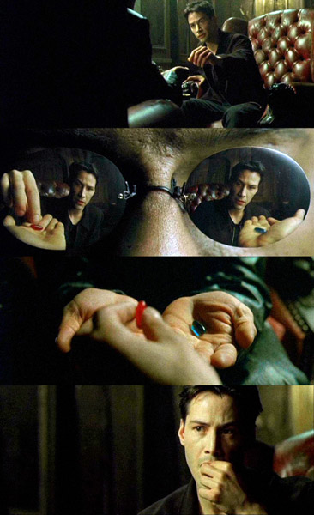
Analysis ready!
Understand the basics of FASTQ
Understand how to demultiplex reads
Remember, all I'm offering is the truth – nothing more
B@G 2016

